Slide 1





Joohyun Kim, Sharath Maddineni, Shantenu Jha Center for Computation and Technology (CCT) Louisiana State University

Slide 2
Content
Introduction : Next-Generation DNA Sequencing (NGS) and Its Significance and New Challenges in Life Sciences and Biomedical Research
Dynamic Application Runtime Environment (DARE) Framework: A Solution Built upon SAGA-BigJob
DARE-NGS : Gateway for NGS Data Analytics and Downstream Analyses on Scalable Distributed HPC and Clouds
Emerging Computational Methods in Life Sciences Workshop at HPDC11)
Teragrid/Blue Waters Symposium on Data-Intensive Analysis, Analytics, and Informatics (April 2011, Pittsburgh)
Teragrid11 workshop

Slide 3
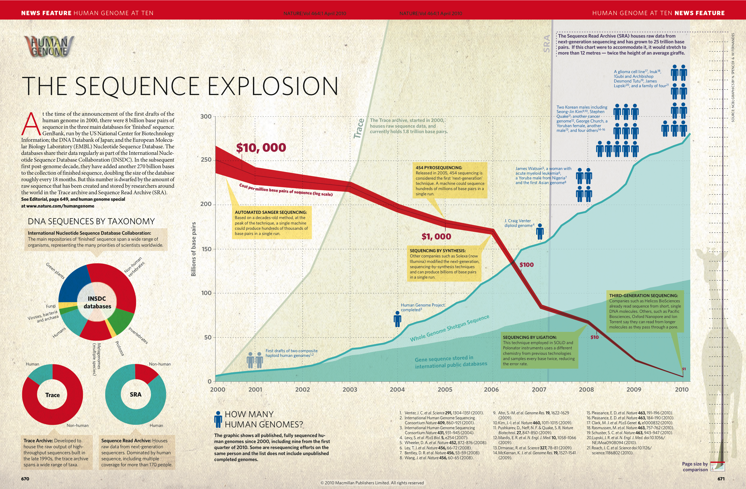
Next-Generation DNA Sequencing (NGS) and Its Impact on Life Sciences and Biomedical Research
Nature, 464, 670 (2010)

Slide 4
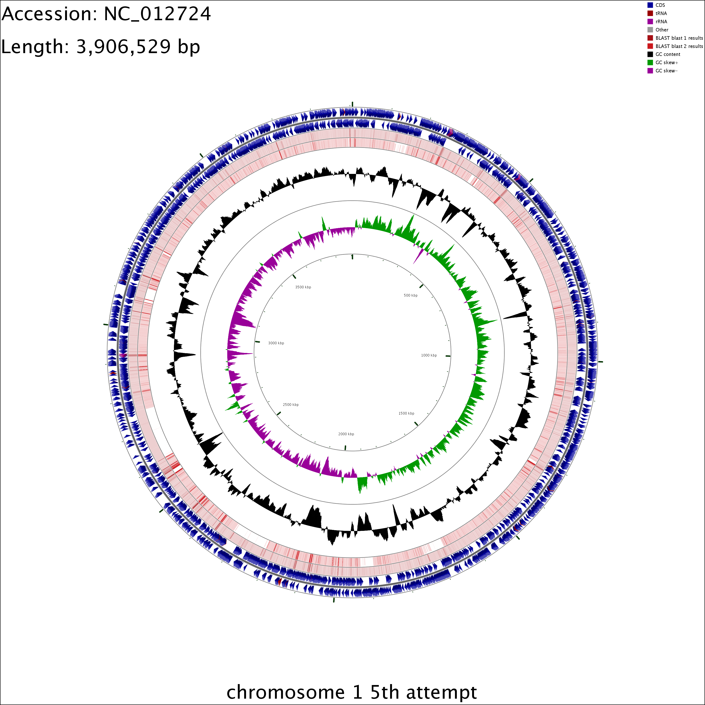
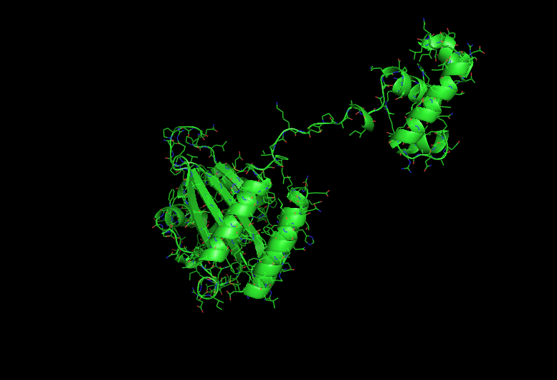
Next-Generation DNA Sequencing (NGS) and Its Impact on Life Sciences and Biomedical Research
Genome2Function : Burkerholderia Glumae, A Rice Pathogen (J. Ham, AgCenter, LSU) – A New Era of Structural Bioinformatics
Homology-based 3D modeling of TofR (Virulence Factor Associated Transcription Factor Binding Protein)
Mapping Result of NGS Data
Notes:
SJ: Something more structured than this is preferable. I still think this is getting too long. There will be other people talking about NGS and we will be the last
To talk about NGS, so a lot of this will be covered. We should give no more than 3-5min motivation.

Slide 5
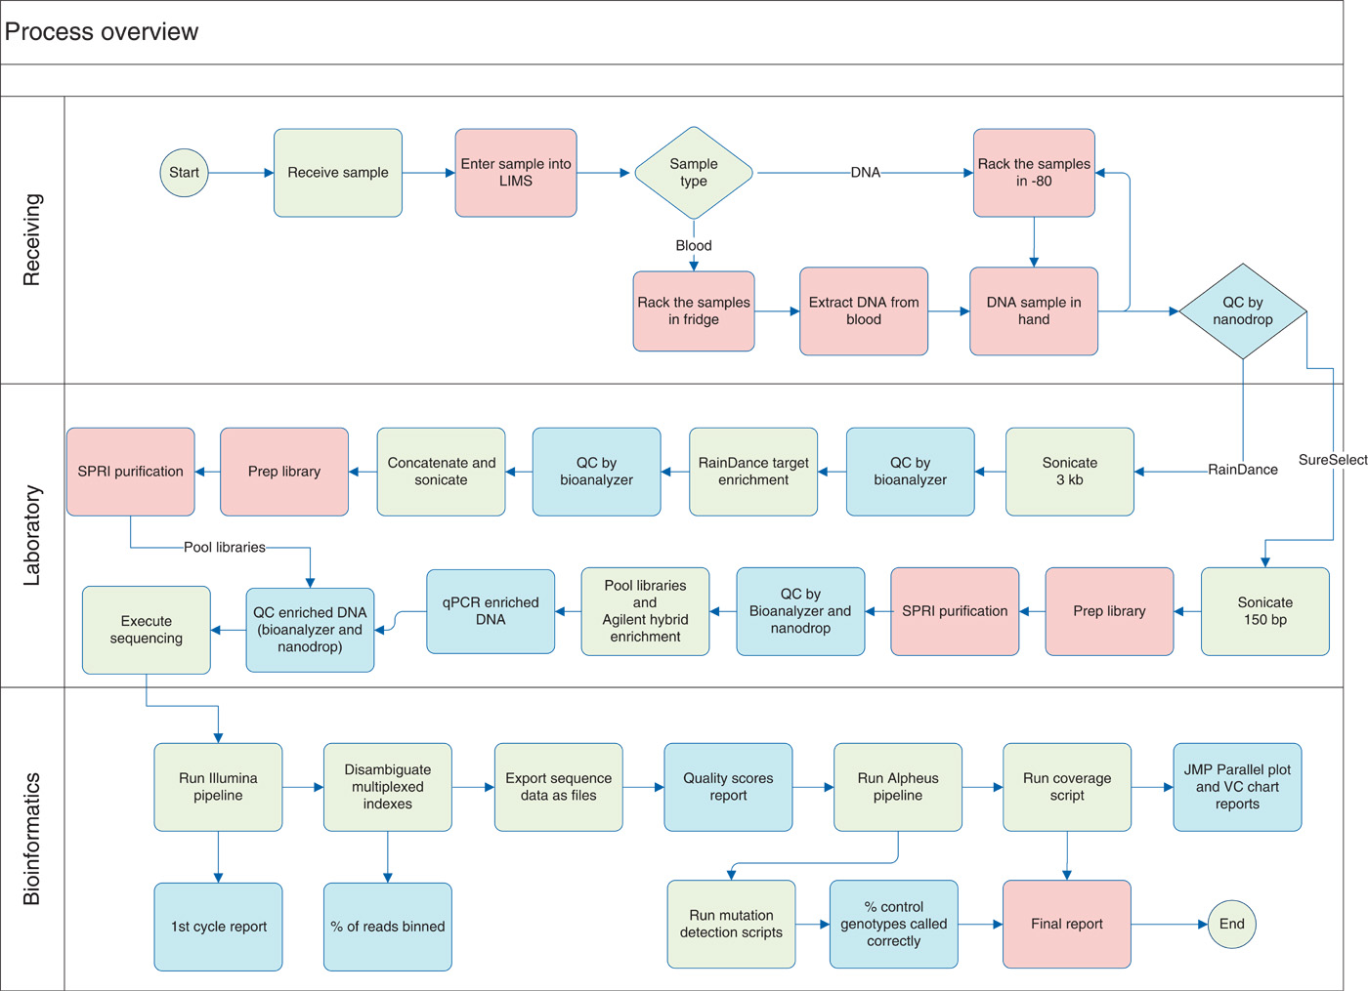
Next-Generation DNA Sequencing (NGS) and Its Impact on Life Sciences and Biomedical Research
High-throughput Sequencing Techniques and Translational Medicine Research
Carrier Testing for Severe Childhood Recessive Diseases by Next-Generation Sequencing
Sci Transl Med 12 January 2011:
Vol. 3, Issue 65, p. 65ra4, Callum J. Bell1 et al.
Notes:
This is getting too long. There will be other people talking about NGS and we will be the last
To talk about NGS, so a lot of this will be covered. We should give no more than 3-5min motivation.

Slide 6
Next-Generation DNA Sequencing (NGS) and Its Impact on Life Sciences and Biomedical Research
Unprecedented novel opportunities for life sciences/biomedical research
High-throughput DNA sequencing
Significant roles of computation (algorithm, methods, implementation, and infrastructure)
Data-intensive computation
Paradigm shift in computational biology touting the importance of the utilization of distributed computing
Notes:
Why is point 4 an impact? Is it not a challenge? I don’t know how we can claim point 5?

Slide 7
Why do we need HPDC and Gateways?
Observation I
➔ Using local compute resources and data storage is too limited.
Observation II
➔ Using Supercomputers or HPC resources is difficult and complex.
Our Solution
➔ Hiding the complexity of using distributed HPC resources and emerging cloud environment. Therefore we propose Gateways…

Slide 8
Why do we need HPDC and Gateways? ➔ Success Story I
Task Level Concurrency and Scale-Out
Compute System | # of cores | # of tasks | Task Concurrency | Bfast (mapping)
Workstation | 4 | 8 | No | ≈18 h
Ranger | 64 | 4 | Yes | 6.5 h
Ranger | 128 | 8 | Yes | 3.4 h
Ranger | 256 | 16 | Yes | 1.95 h
Case | HPC System | # of cores | Bfast (mapping)
I | QB | 256 | 2.66 h
II | Ranger | 128 | 2.11 h
 | QB | 128
Read Data
(12 GB)
Reference Genome
I
II
Notes:
(JK) Here, upper two tables represent the benefits of task level concurrency and scale-out strategy

Slide 9
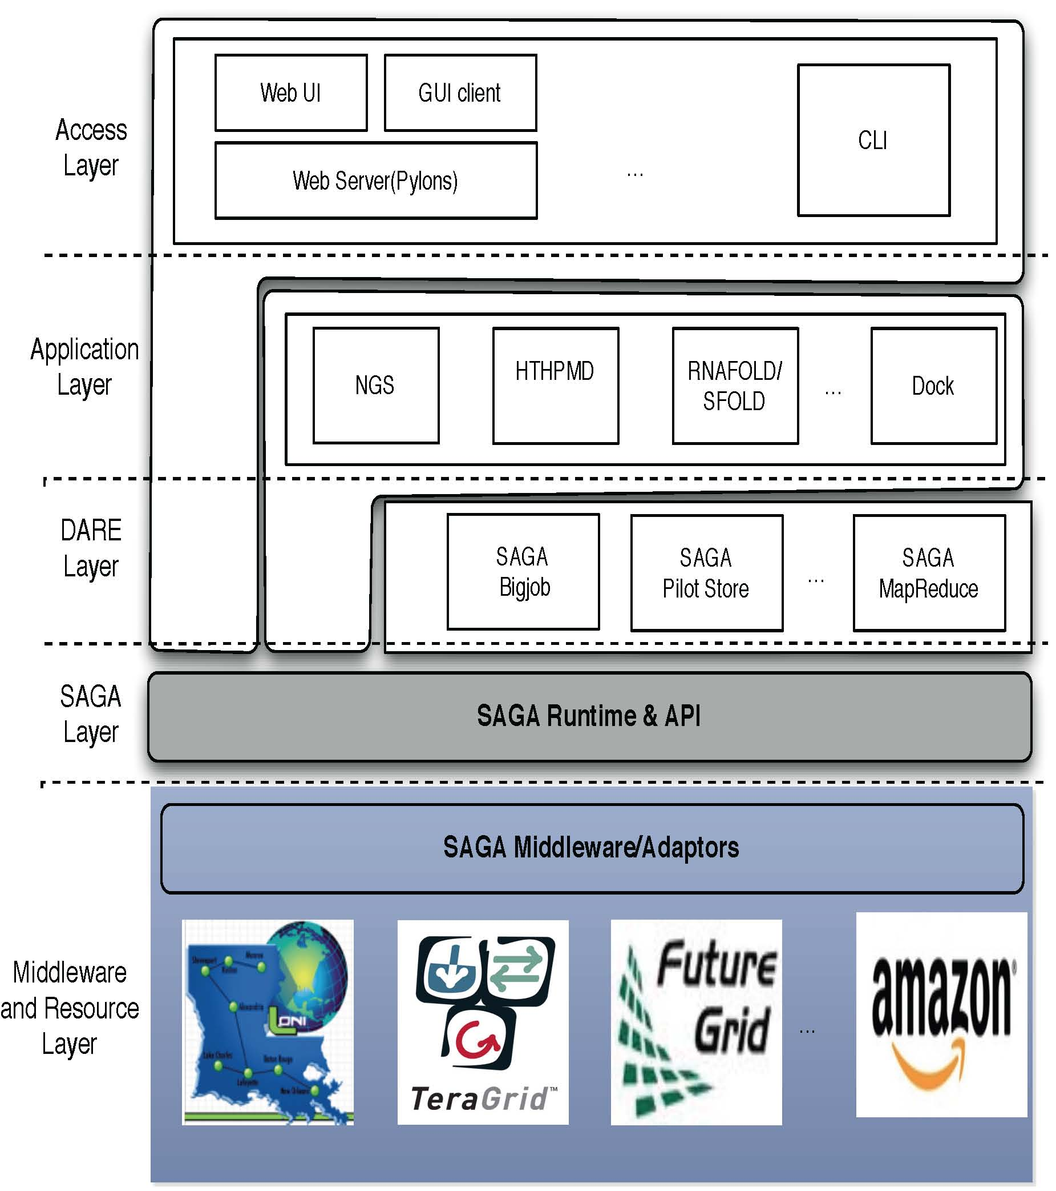
DARE Framework: A Solution Built upon SAGA-BigJob
Notes:
Fixed the diagram.. Please remove next slide if you are OK with this

Slide 10
DARE Framework: A Solution Built upon SAGA-BigJob
Frameworks: Logical structure for Capturing Application Requirements, Characteristics & Patterns
Pattern: Commonly recurring modes of computation
Programming, Deployment, Execution, Data-access..
Abstraction: Mechanism to support patterns and application characteristics
Frameworks designed to either:
Support Patterns: Map-Reduce, Master-Worker, Hierarchical Job-Submission
Provide the abstractions and/or support the requirements & characteristics of applications
i.e. Encode a Usage-Mode using a Framework

Slide 11
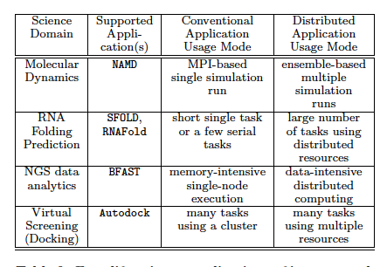
DARE Framework : Success Stories - Four Life-Science Applications

Slide 12
DARE-NGS : A Gateway for NGS-Analytics and Downstream Analyses
Overview - Computational/Bioinformatics Strategies for Genomic Data Analysis
WGS, CHIP-Seq, RNA-Seq: Billions Short Reads
Mapping
De Novo Assembly
Whole Genome Analysis (WGS)
Exome Analysis
Transcriptome Analysis
(RNA-seq)
Genome-wide DNA-protein interactions
(ChIP-seq)
Functional Annotation, Pathway Analysis – Cell Development & Differentiation, Host-Pathogen interaction, Biomedical research
Notes:
SJ: Color coding is a bit misleading. Does purple (right sight, lower level) represent analysis? If so, be sure to say so

Slide 13
DARE-NGS : A Gateway for NGS-Analytics and Downstream Analyses
Exome analysis
PI : Tuomo Rankinen (HGL, PBRC)/PBRC GCF
Task : Large scale mapping and genome variation discovery
B. Fusion gene discovery for cancer research
PI : Erik Flamington (Tulane U)/Carl (Tulane GCF)
Task : Tophatfusion
C. C. elegans transcription factor (NHR-6) binding
PI : Chris Gissendanner (ULM) (LBRN PI)
Task : ChIP-seq pipeline
D. Rice-B.Glumae (Host-Pathogen)
PI : Jong-hyun Ham (AgCener, LSU)
Task : RNA-Seq, integrative Infrastructure for Drug Discovery targeting Quorum-Sensing mechanism
Notes:
SJ: Something more structured than this is preferable. I still think this is getting too long. There will be other people talking about NGS and we will be the last
To talk about NGS, so a lot of this will be covered. We should give no more than 3-5min motivation.

Slide 14
DARE-NGS : A Gateway for NGS-Analytics and Downstream Analyses
ChIP-Seq pipeline
: Data processing
: Databases
Mapping
Peak Calling

Slide 15

Acknowledgements
SAGA Team and DPA Team and the UK-EPSRC
(UK EPSRC: DPA, OMII-UK , OMII-UK PAL)
People
SAGA D&D: Hartmut Kaiser, Ole Weidner, Andre Merzky, Lukasz Lacinski, João Abecasis, Chris Miceli, Bety Rodriguez-Milla
SAGA Users: Andre Luckow, Yaakoub el-Khamra, Kate Stamou, Cybertools (Abhinav Thota, Jeff, N. Kim), Owain Kenway
Google SoC: Michael Miceli, Saurabh Sehgal, Miklos Erdelyi
Collaborators and Contributors: Steve Fisher & Group, Sylvain Renaud (JSAGA), Go Iwai & Yoshiyuki Watase (KEK)
DPA: Dan Katz, Murray Cole, Manish Parashar, Omer Rana, Jon Weissman
Collaboration
Jong Hyun Ham (Plant Pathology and Crop Physiology, LSU) B. Glumae
Tuomo Rankinen (Human Genome Lab, PBRC) Human Exome
Genome Core Facility, PBRC
Support
Louisiana Biomedical Research Network (LBRN)

